Slide 1

DATA ENGINEERING 2
CHAPTER 1
Laszlo Sallo
OCTOBER 2020

Slide 2
DATA WAREHOUSE IMPLEMENTATION
FAILURE RATE
80%

Slide 3
REASONS
REASONS
Complex
Easy get lost
Lots of documentation
Hard to maintain
Data quality / Junks

Slide 4
REASONS
A full corporate DW implementation
takes years
High cost
Lost commitment
Change in business

Slide 5
REASONS
Long term design is not easy
World is changing quickly
DW is inflexible on change

Slide 6
REASONS
REASONS
Requires the whole organization
Not just IT
Organizational silos
Identify the key users
Unified data dictionary

Slide 7
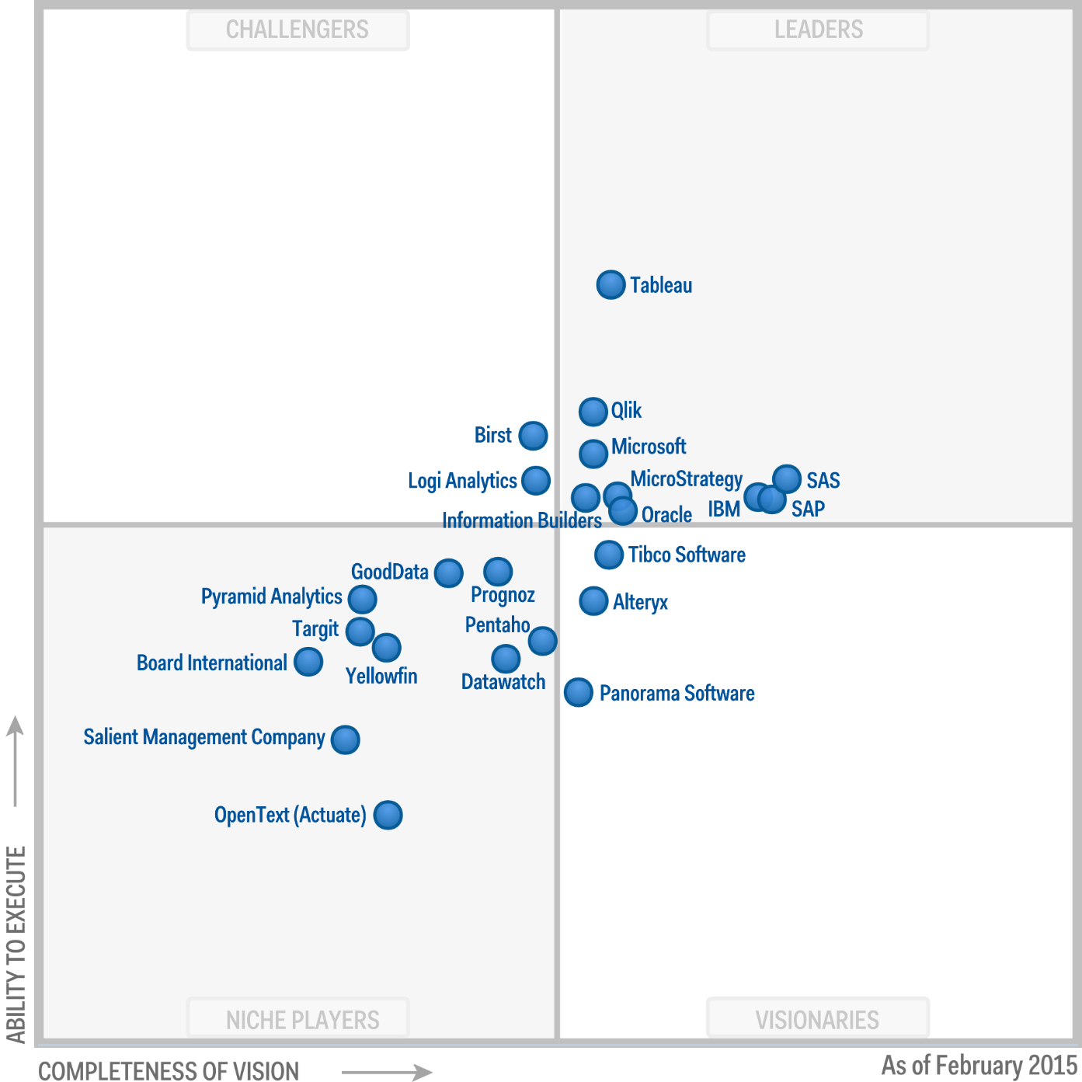
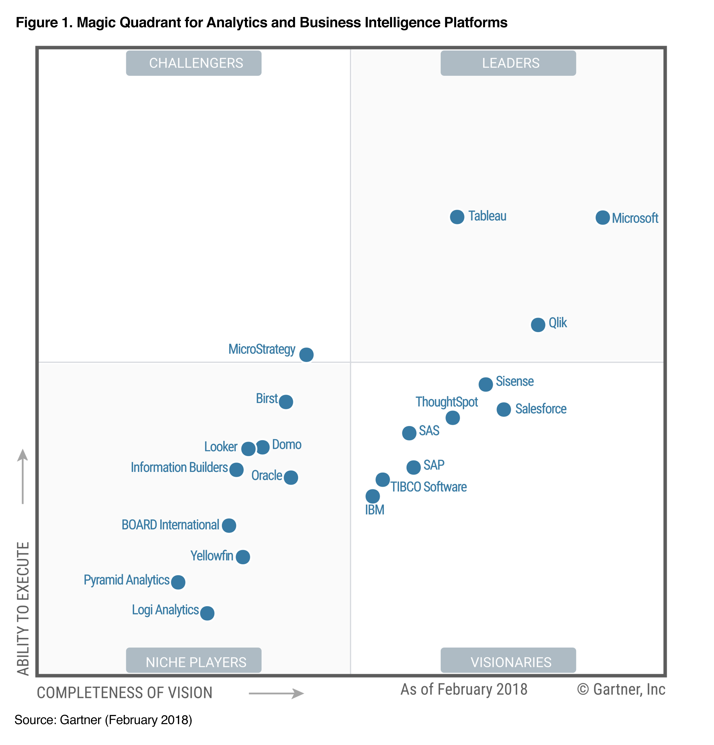
GARTNER MAGIC QUADRANT FOR BI AND ANALYTICS PLATFORMS
2015
2018

Slide 8

DATA SYSTEM REVOLUTION IN LATE 2000’S

Slide 9
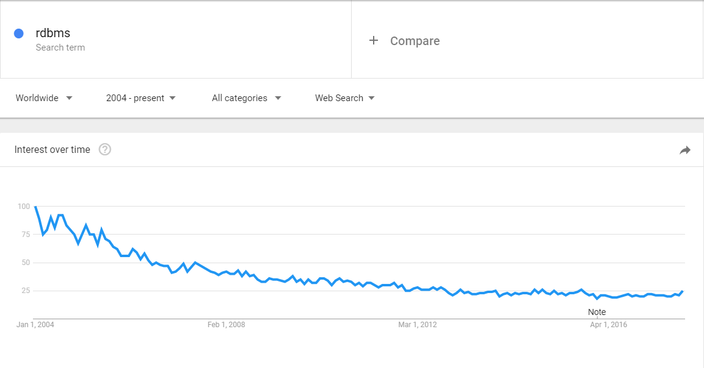
RDBMS

Slide 10
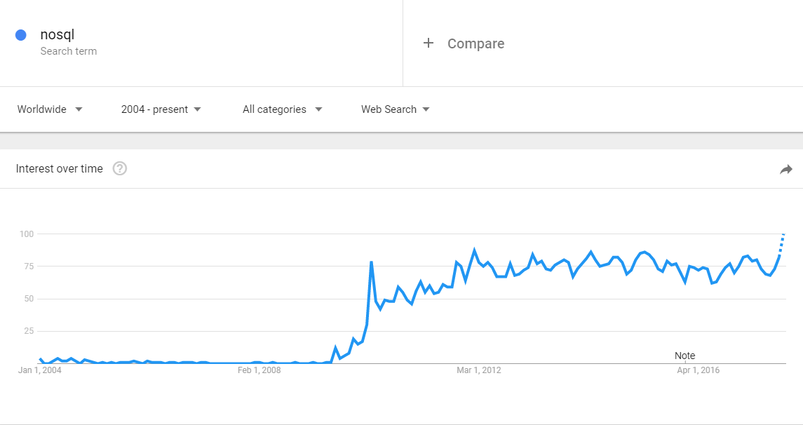
NOSQL

Slide 11
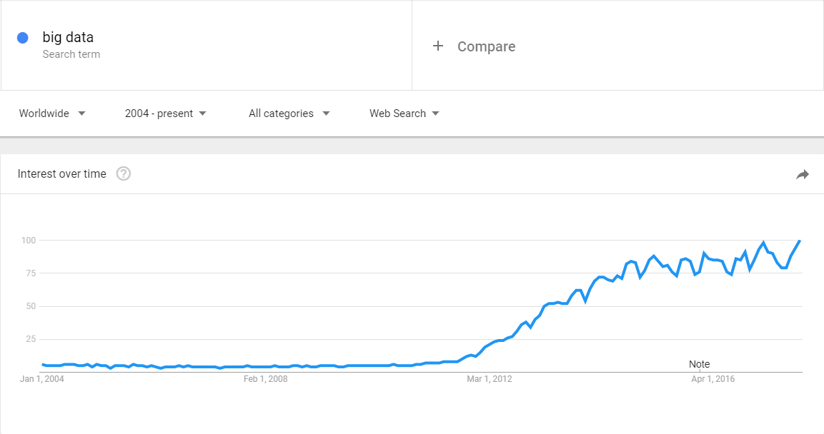
BIG DATA

Slide 12









DATA LANDSCAPE BEFORE 2010

Slide 13
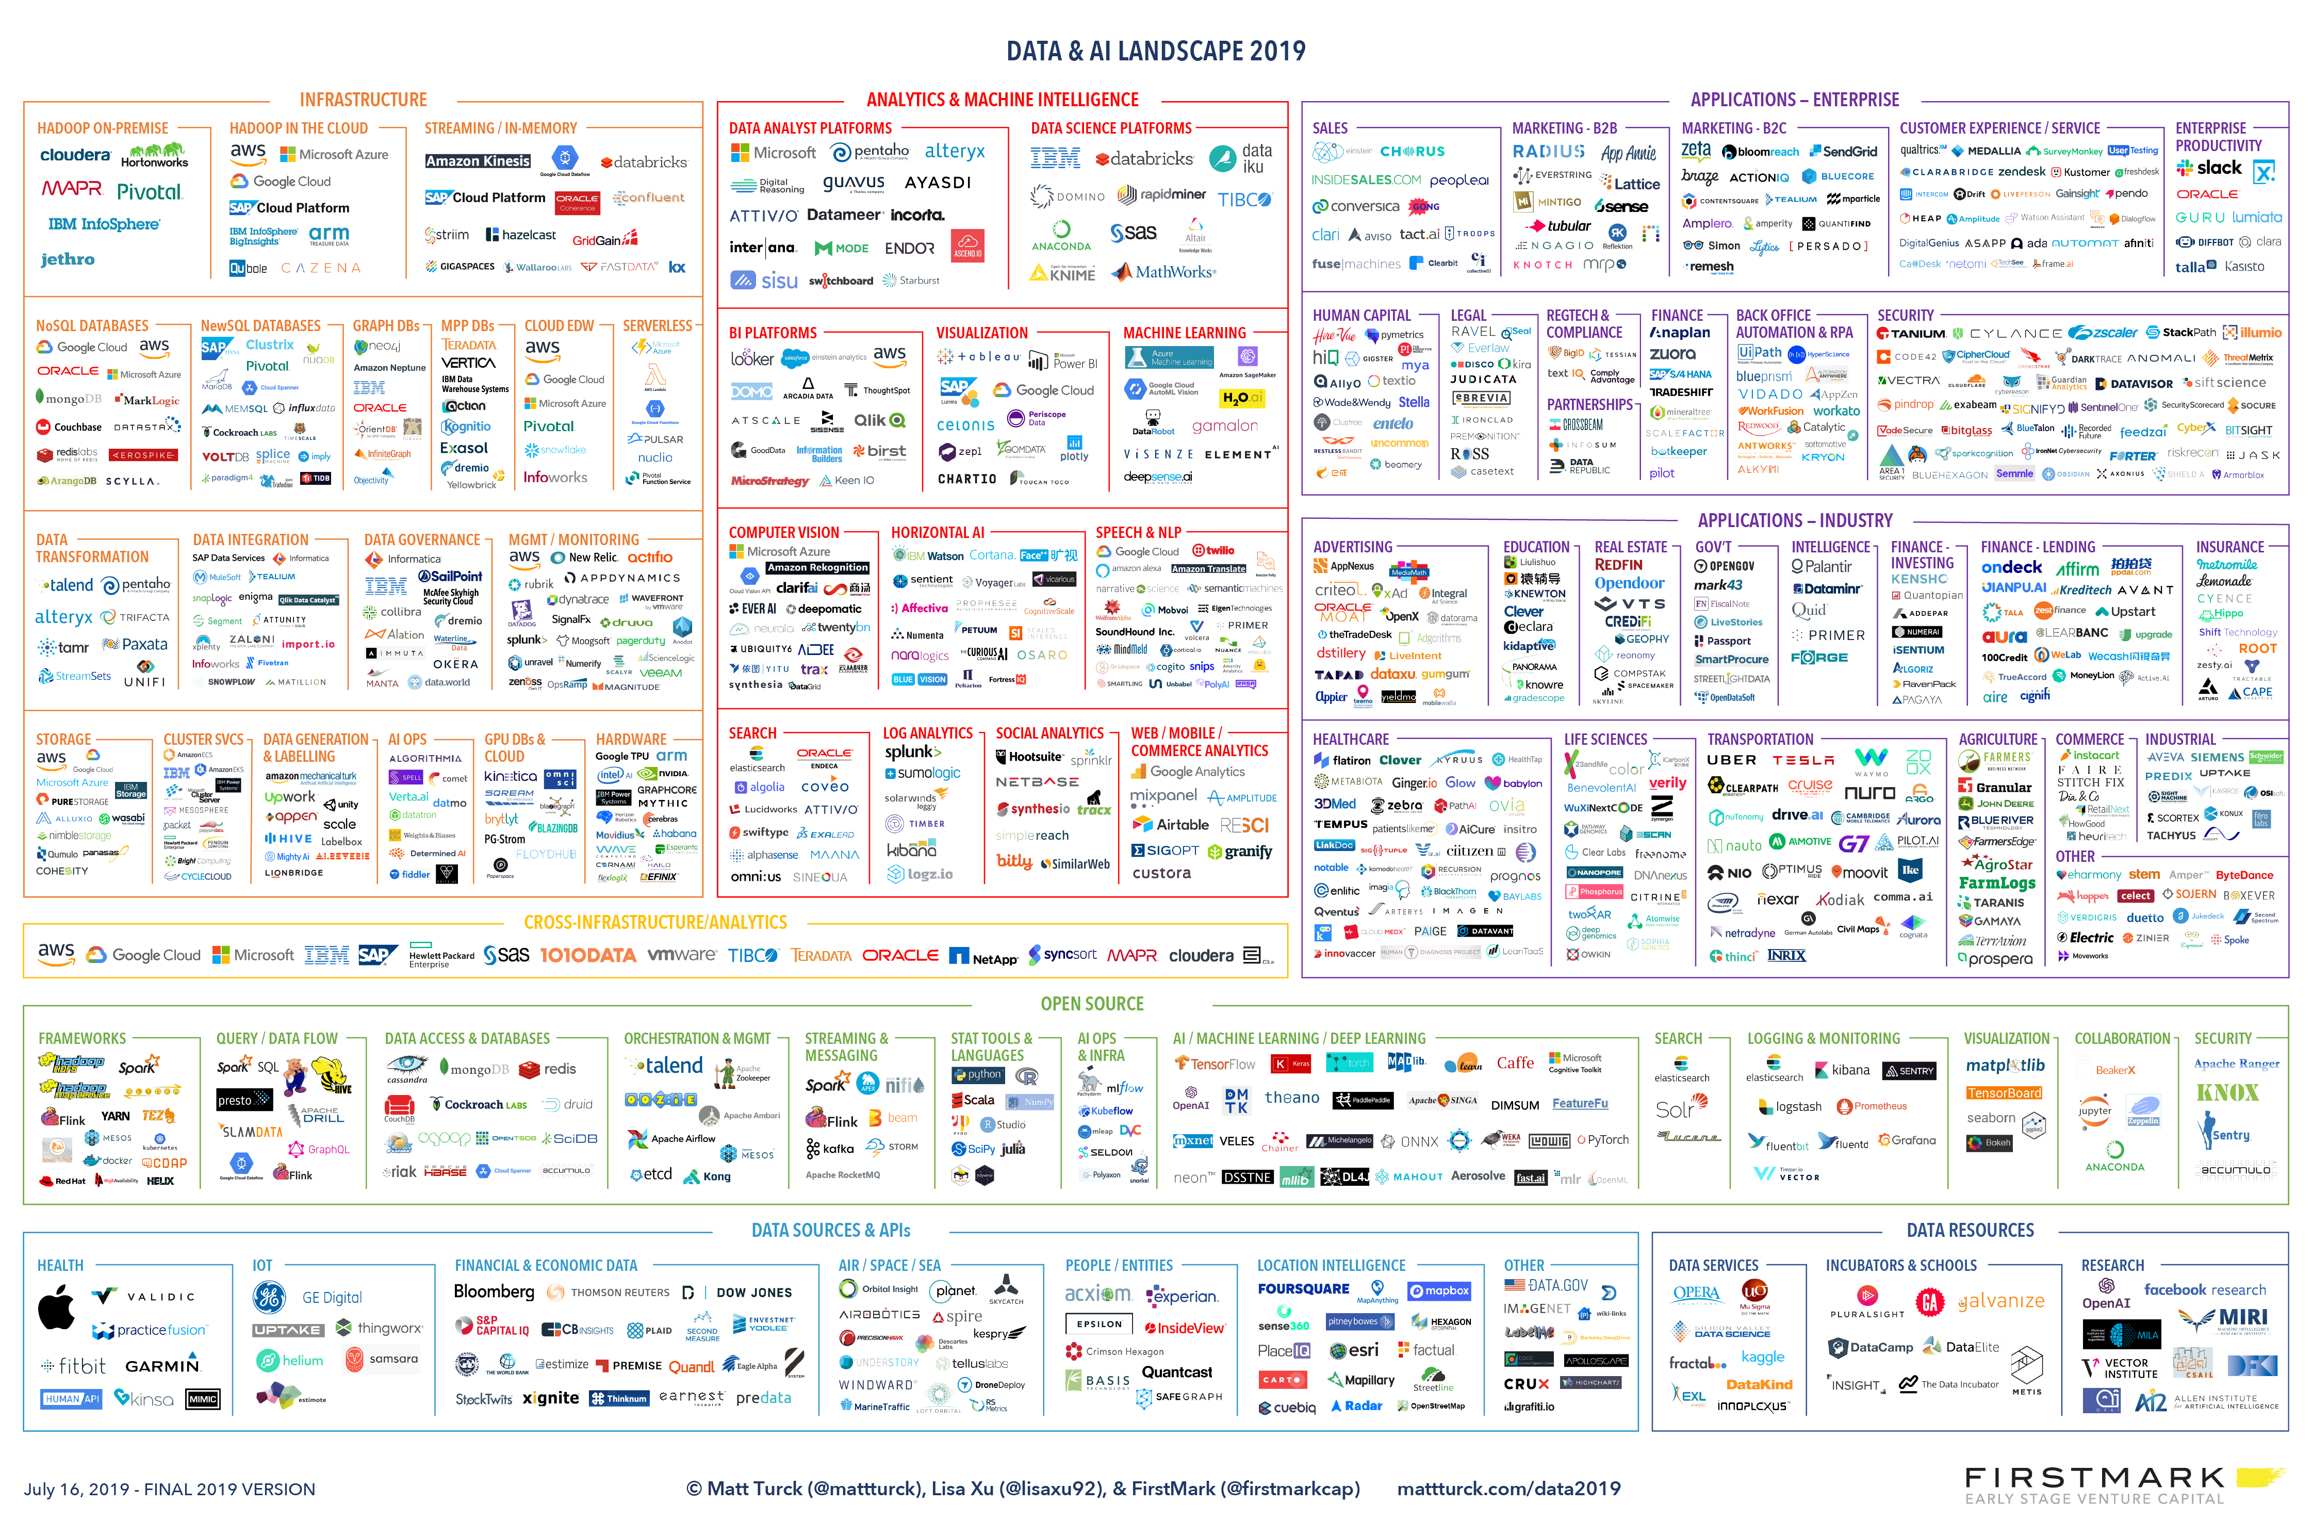

Slide 14
WHAT HAPPENED?
WHAT HAPPENED TO THE WORLD
TO GENERATE SUCH A
CHANGE ?

Slide 15

CHALLENGES
SOCIAL MEDIA

Slide 16

CHALLENGES
MOBILITY & IoT

Slide 17

CHALLENGES
DIGITAL TRANSFORMATION

Slide 18
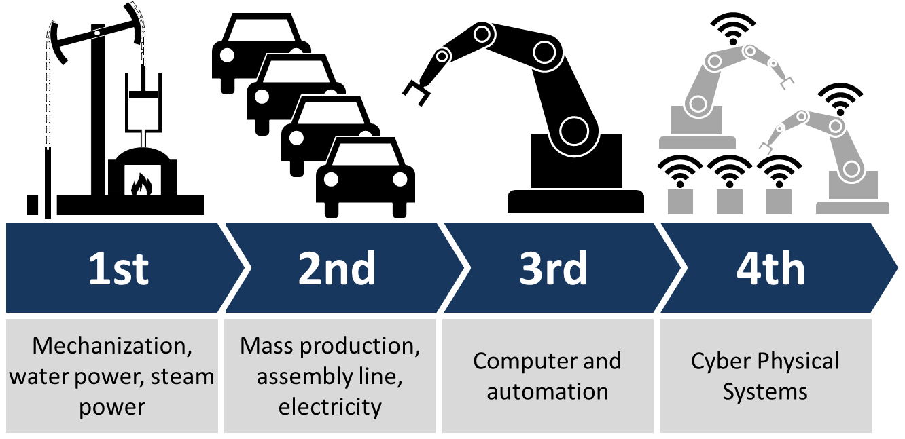
CHALLENGES
INDUSTRY 4.0 or SMART FACTORY

Slide 19

CHALLENGES
STARTUPS

Slide 20
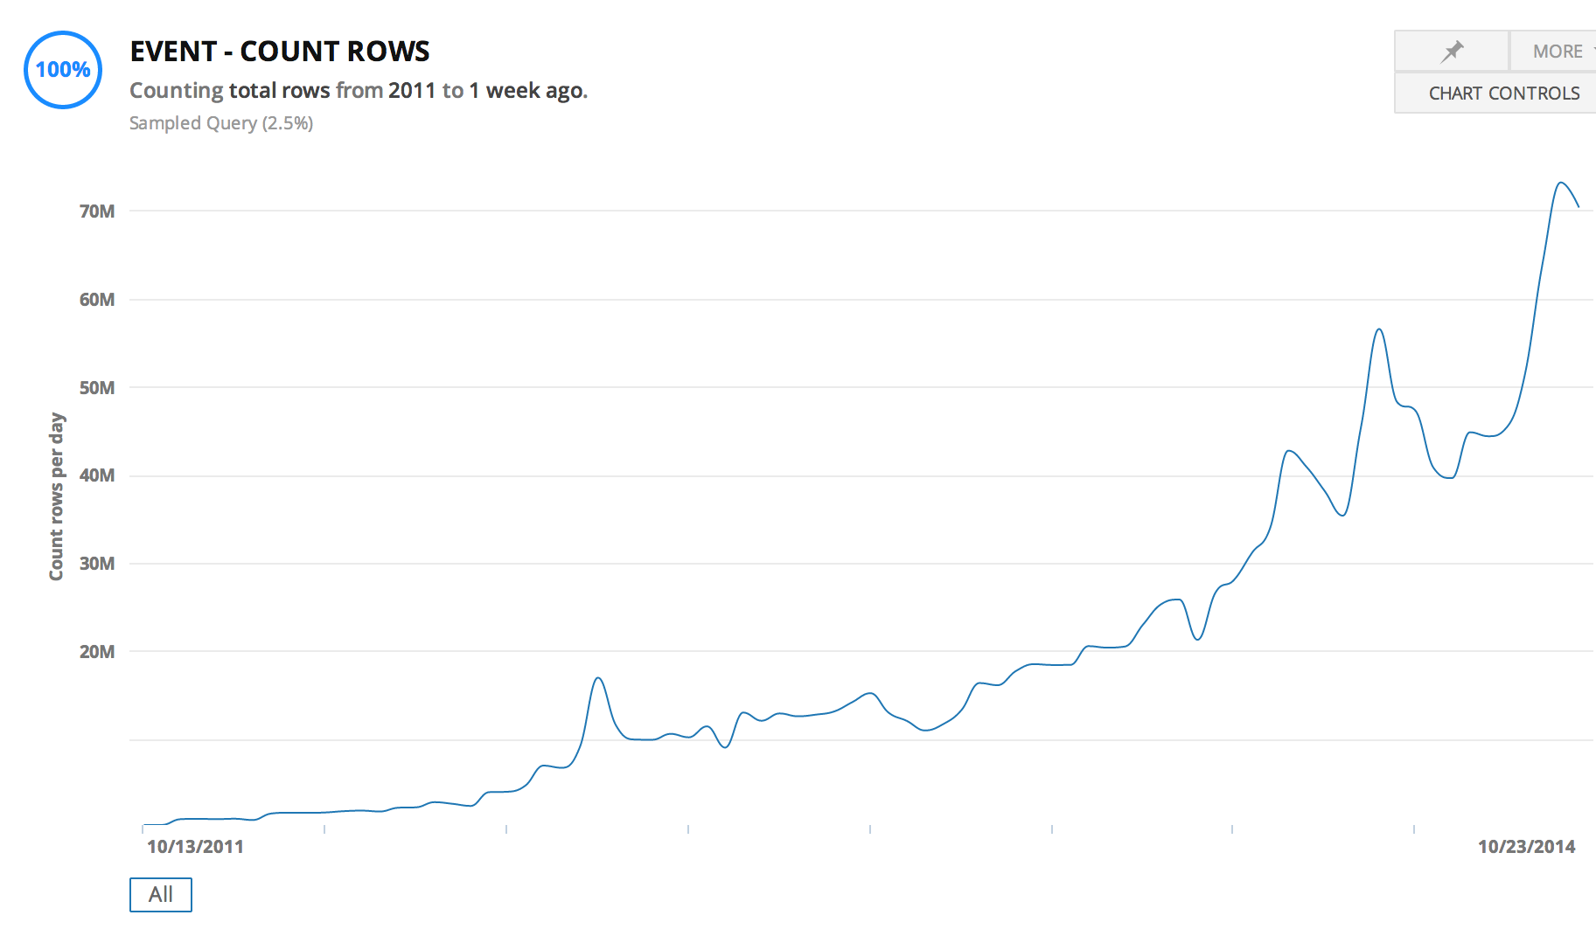

STARTUP DATA SCALE

Slide 21
COST OF DATA
1 Gigabyte
$2.64 billion in 1965
$0.09 in 2020 (India)

Slide 22



THE ENGINES OF CHANGE
OPEN SOURCE SOFTWARE IS SOFTWARE WITH SOURCE CODE THAT ANYONE CAN
INSPECT,
MODIFY,
OR ENHANCE.

Slide 23
DEMAND 1
DEMAND FOR EASY SCALE
Cheap scale up and down

Slide 24
DEMAND 2
NEED FOR HIGH AVAILABILITY
We are 24/7 dependent on digital
Notes:
Slow / Bad design
Deployment
Hardware / Network failure
Security threats
Bug in a software
3rd party failure

Slide 25
DEMAND 3
HANDLE LARGER DATA
Cheap storage
Analyze large datasets

Slide 26
DEMAND 4
APPETITE FOR REAL TIME DATA
Real time operations
Real time analytics
Notes:
Automated cars
Real-time bidding (RTB)
Stock exchange
Telemedicine
Blockchain

Slide 27
SUMMARIZED
DEMAND FOR
Real time + Highly available + Large data
In
Economically feasible way
Notes:
Automated cars
Real-time bidding (RTB)
Stock exchange
Telemedicine
Blockchain

Slide 28
THE FIRST IDEA: DISTRIBUTED SYSTEMS

Slide 29


SERVER – CLIENT ARCHITECTURE
CLIENT
CLIENT
CLIENT
SERVER

Slide 30
TERMINOLOGY
THROUGHPUT (LOAD) (hits/second)
LATENCY (RESPONSE TIME) (millisecond)

Slide 31
SCALING
CLIENT
CLIENT
CLIENT
VERTICAL
SCALING
CLIENT

Slide 32

DISTRIBUTED SYSTEMS
CLIENT
CLIENT
CLIENT
HORIZONTAL
SCALING
SERVER CLUSTER
NODE 1
NODE 2
NODE 3
NODE 4

Slide 33
HORIZONTAL SCALING - REPLICATION
CLIENT
CLIENT
CLIENT
REPLICATION
SCALE ONLY FOR PERFORMANCE
LOAD BALANCER
SERVER CLUSTER
COMPANY
DATA
COMPANY
DATA
COMPANY
DATA
COMPANY
DATA

Slide 34
HORIZONTAL SCALING - PARTITIONING
CLIENT
CLIENT
CLIENT
PARTITIONING
HAVE TO KNOW WHERE TO GO
UNBALANCED
PROXY
SERVER CLUSTER
COMPANY
EUROPE
DATA
COMPANY
AMERICA
DATA
COMPANY
ASIA
DATA
COMPANY
AFRICA
DATA

Slide 35
HORIZONTAL SCALING - SHARDING
CLIENT
CLIENT
CLIENT
SHARDING
CAN BE SLOW
AGGREGATOR
SERVER CLUSTER
COMPANY
DATA A
COMPANY
DATA B
COMPANY
DATA C
COMPANY
DATA D

Slide 36
BARE METAL SERVER
ISSUES
COSTLY
COMPLICATED
HARD TO SCALE

Slide 37
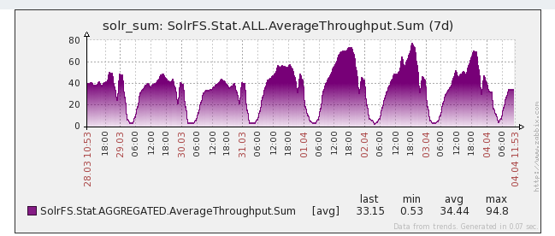
USE CASE – DAY/NIGHT PROBLEM
THROUGHPUT

Slide 38
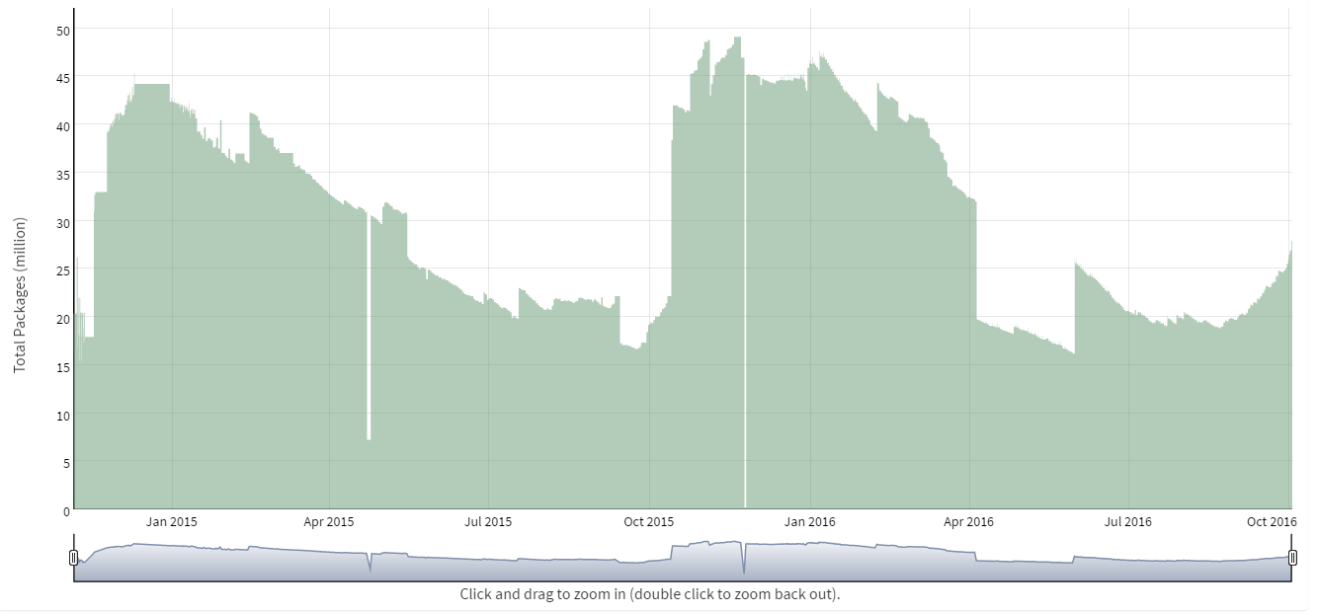
USE CASE – SEASONAL INVENTORY
DATA SIZE

Slide 39
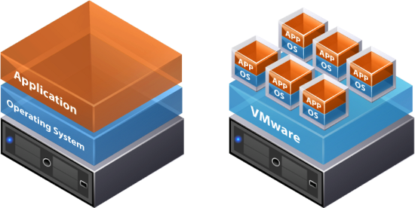
THE NEXT IDEA: VIRTUALIZATION + DATA CENTERS

Slide 40
VIRTUALIZATION
ISSUES
COSTLY
COMPLICATED
HARD TO SCALE
SECURITY: PRIVATE VS PUBLIC

Slide 41

THE NEXT IDEA: CLOUD

Slide 42
USE CASE - AMAZON
…
5% utilized
NODE 1
NODE 2
NODE 3
NODE 4

Slide 43

CLOUD
2006

Slide 44
WHAT IS CLOUD?
A PIECE OF SOFTWARE WHICH OFFERS:
TOOLS TO REMOTELY AND SIMPLY HANDLE
VIRTUAL HARDWARE AND/OR SOFTWARE.

Slide 45
CLOUD
ISSUES
COSTLY
COMPLICATED
HARD TO SCALE
SECURITY
BENEFITS
GEO SAFE
AUTOMATION
ICA (Infrastructure as code)

Slide 46
FINANCIAL CONDUCT AUTHORITY (UK)
We see no fundamental reason why cloud services (including public cloud services) cannot be implemented, with appropriate consideration, in a manner that complies with our rules.
(2016.07.07)
https://www.fca.org.uk/publications/finalised-guidance/fg16-5-guidance-firms-outsourcing-%E2%80%98cloud%E2%80%99-and-other-third-party-it

Slide 47
FURTHER BENEFITS
XAAS
IAAS – Infrastructure as a service
PAAS – Platform as a service
STAAS – Storage as a service
SAAS – Software as a service
DAAS – Database as a services
Serverless

Slide 48



CLOUD PROVIDERS

Slide 49

PRACTICE: AWS RDS

Slide 50
RDBMS IN A NEW PERSPECTIVE
RDBMS
= DESIGNED FOR OPERATIONS
= DESIGNED TO BE PERFECT IN EVERY SITUATION

Slide 51
CHARACTERISTICS OF RDBMS
Consistency is always guaranteed
Choose consistency over availability
All or nothing transactions
FOR MORE READ ABOUT: ACID & CAP
Notes:
Consistency: Availability correlates with revenue and consistency generally does not.
Availability: partial availably ?
100% PERFECT
= $$$$$

Slide 52

DO WE REALLY NEED RDBMS PERFECTION?

Slide 53
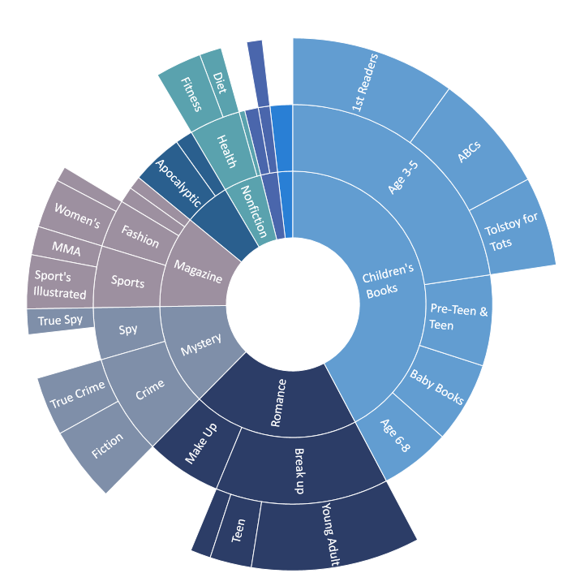
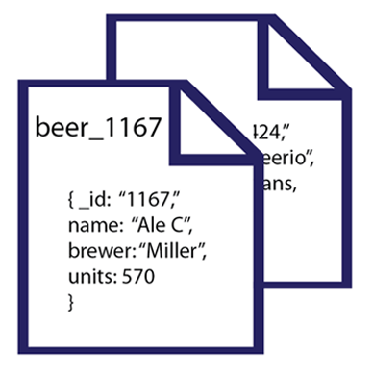
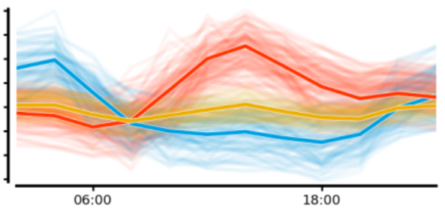
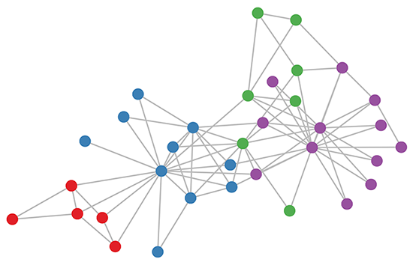
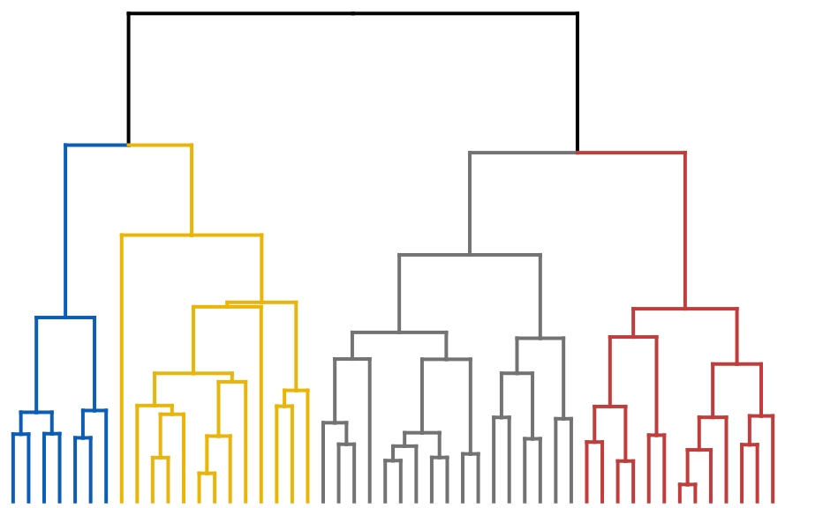
CAN WE GO BEYOND TABULAR DATA?

Slide 54
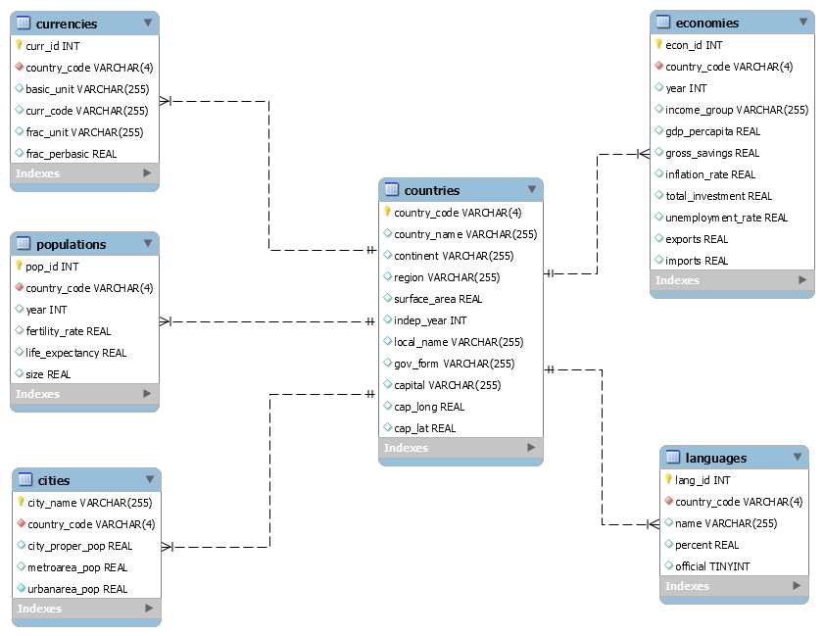
DO WE NEED THOSE RIGID SCHEMAS?

Slide 55
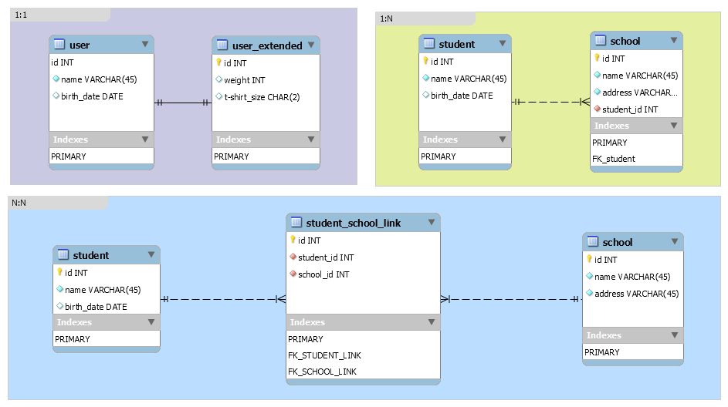
INDEXING
DB
Index

Slide 56

THE NEXT IDEA: BUILD NEW DATA TOOLS

Slide 57


SPECIALIZED
NEW TOOLS
RDBMS

Slide 58
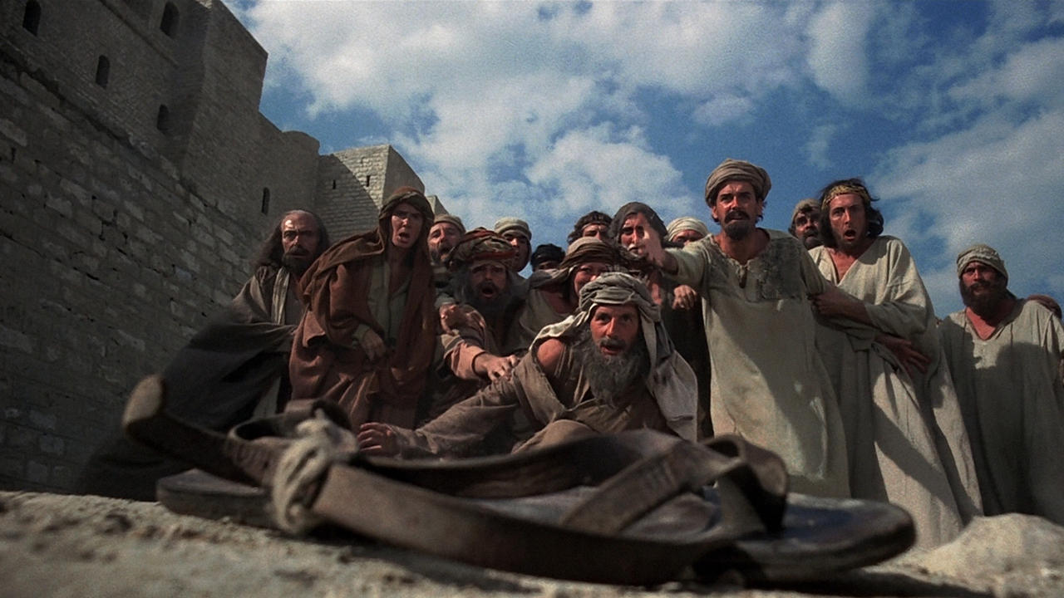
BIG DATA, NOSQL, …

